Slide 1
Random Forest

Slide 2
Ensemble learning (Ensembling)
Machine learning technique that combines several base models in order to produce one optimal predictive model.
Weak classifiers
Combine into single prediction

Slide 3
BAGGing – Bootstrapped AGGregating
Sno | X1 | X2 | Y
4 | 144 | 29 | No
2 | 529 | 34 | Yes
4 | 144 | 29 | No
3 | 125 | 67 | No
Sno | X1 | X2 | Y
1 | 432 | 29 | Yes
2 | 529 | 34 | Yes
3 | 125 | 67 | No
4 | 144 | 29 | No
Sno | X1 | X2 | Y
3 | 125 | 67 | No
4 | 144 | 29 | No
4 | 144 | 29 | No
1 | 432 | 29 | Yes
Random sample rows
with replacement
Sno | X1 | X2 | Y
3 | 125 | 67 | No
2 | 529 | 34 | Yes
3 | 125 | 67 | No
4 | 144 | 29 | No

Slide 4
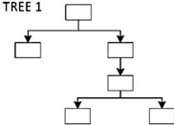
Using a random set of variables every time
Sno | X1 | X3 | Y
4 | 144 | 103 | No
2 | 529 | 379 | Yes
4 | 144 | 103 | No
3 | 125 | 317 | No
Random sample rows with replacement
Sno | X1 | X2 | X3 | X4 | Y
1 | 432 | 29 | 313 | 6 | Yes
2 | 529 | 34 | 379 | 2 | Yes
3 | 125 | 67 | 317 | 4 | No
4 | 144 | 29 | 103 | 8 | No
Sno | X1 | X2 | Y
3 | 125 | 67 | No
4 | 144 | 29 | No
4 | 144 | 29 | No
1 | 432 | 29 | Yes
Random subset of X variables
Sno | X4 | X2 | Y
3 | 4 | 67 | No
2 | 2 | 34 | Yes
3 | 4 | 67 | No
4 | 8 | 29 | No

Slide 5

Basic Flow of random forest
Draw multiple random samples, with replacement, from the data
(this sampling approach is called the bootstrap).
Using a random subset of predictors at each stage, fit a classification (or regression) tree to each sample (and thus obtain a “forest”).
Combine the predictions/classifications from the individual trees to obtain improved predictions.
Use voting for classification and averaging for prediction.

Slide 6
Out of Bag (OOB) data points & OOB Error
When we create a bootstrapped dataset, ~1/3 of the original data does not end up in the boot strapped dataset
This is called out-of-bag dataset
Sno | X1 | X3 | Y
4 | 144 | 103 | No
2 | 529 | 379 | Yes
4 | 144 | 103 | No
3 | 125 | 317 | No
Sno | X1 | X2 | X3 | X4 | Y
1 | 432 | 29 | 313 | 6 | Yes
2 | 529 | 34 | 379 | 2 | Yes
3 | 125 | 67 | 317 | 4 | No
4 | 144 | 29 | 103 | 8 | No
Sno | X1 | X2 | Y
3 | 125 | 67 | No
4 | 144 | 29 | No
4 | 144 | 29 | No
1 | 432 | 29 | Yes
Sno | X4 | X2 | Y
3 | 4 | 67 | No
2 | 2 | 34 | Yes
3 | 4 | 67 | No
4 | 8 | 29 | No
6

Slide 7
How to calculate accuracy
OOB samples used to measure how accurate our random forest isby the ratio of out of bag samples correctly classified by the random forest model
Proportion of OOB samples incorrectly classified –> out of bag error
7

Slide 8
How to decide on how many variables to use per step?
Compare OOB error for using 2 variables per step, 3 variables and so on
Choose the most accurate set of variables
Typically, we start by using square root of number of variables
Then try a few settings above and below the value
Use GridSearchCV to try out various combinations
8

Slide 9
Summary of Random forest
Consists of a large number of individual decision trees that operate as an ensemble
Each tree in the random forest spits out a class prediction
class with most votes
becomes model’s prediction
A large number of relatively uncorrelated models (trees) operating as a committee will outperform any of the individual models.
fundamental concept -
wisdom of crowds
9

Slide 10
Overall flow of the RF classification process
EDA – Univariate
Boxplot for num var
Barplot for cat var
Feature engineering
– convert relevant variables to categorical
Find Baseline Y class
% to check class imbalance
Read csv file
EDA – bivariate
Boxplot – num X vs cat Y
Stacked bar – cat X vs Y
Split into training and test sets
Build a random forest model
Tune ntree & mtry
Model performance
Acc, sens, spec
AUC
Predict for train & test
Variable importance
10

Slide 11
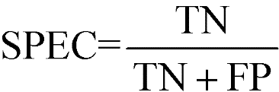
Confusion Matrix
Confusion Matrix – A 2X2 tabular structure reflecting the performance of the model in four blocks
Accuracy – How accurately / cleanly does the model classify the data points. Lesser the false predictions, more the accuracy
Sensitivity / Recall – How many of the actual True data points are identified as True data points by the model . Remember, False Negatives are those data points which should have been identified as True.
Specificity – How many of the actual Negative data points are identified as negative by the model
Precision – Among the points identified as Positive by the model, how many are really Positive
Confusion Matrix | Predicted Positive | Predicted Negative
Actual Positive | True Positive | False Negative
Actual Negative | False Positive | True Negative

Slide 12
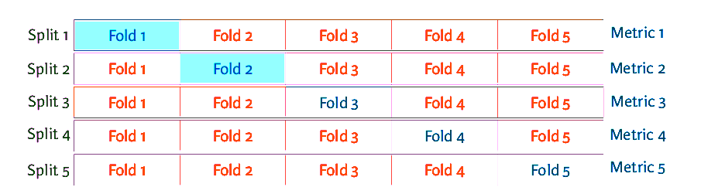

Cross Validation
Source : towardsdatascience.com.

